Slide 1
BIOMEDIN 215 Data Science in Medicine
Nigam Shah, MBBS, PhD
nigam@stanford.edu

Slide 2
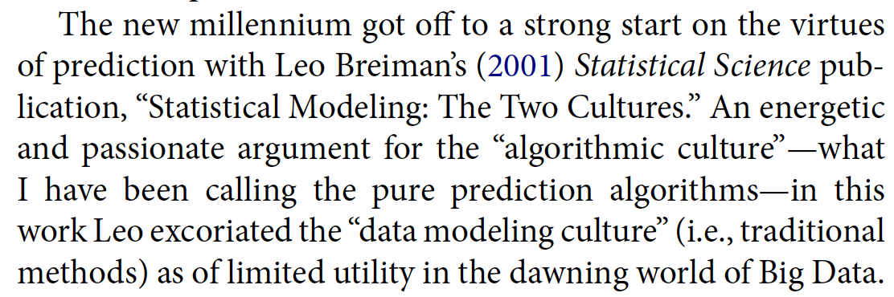
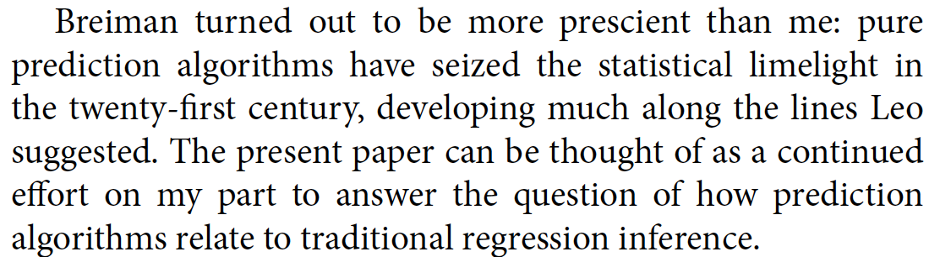
From the assigned reading …

Slide 3
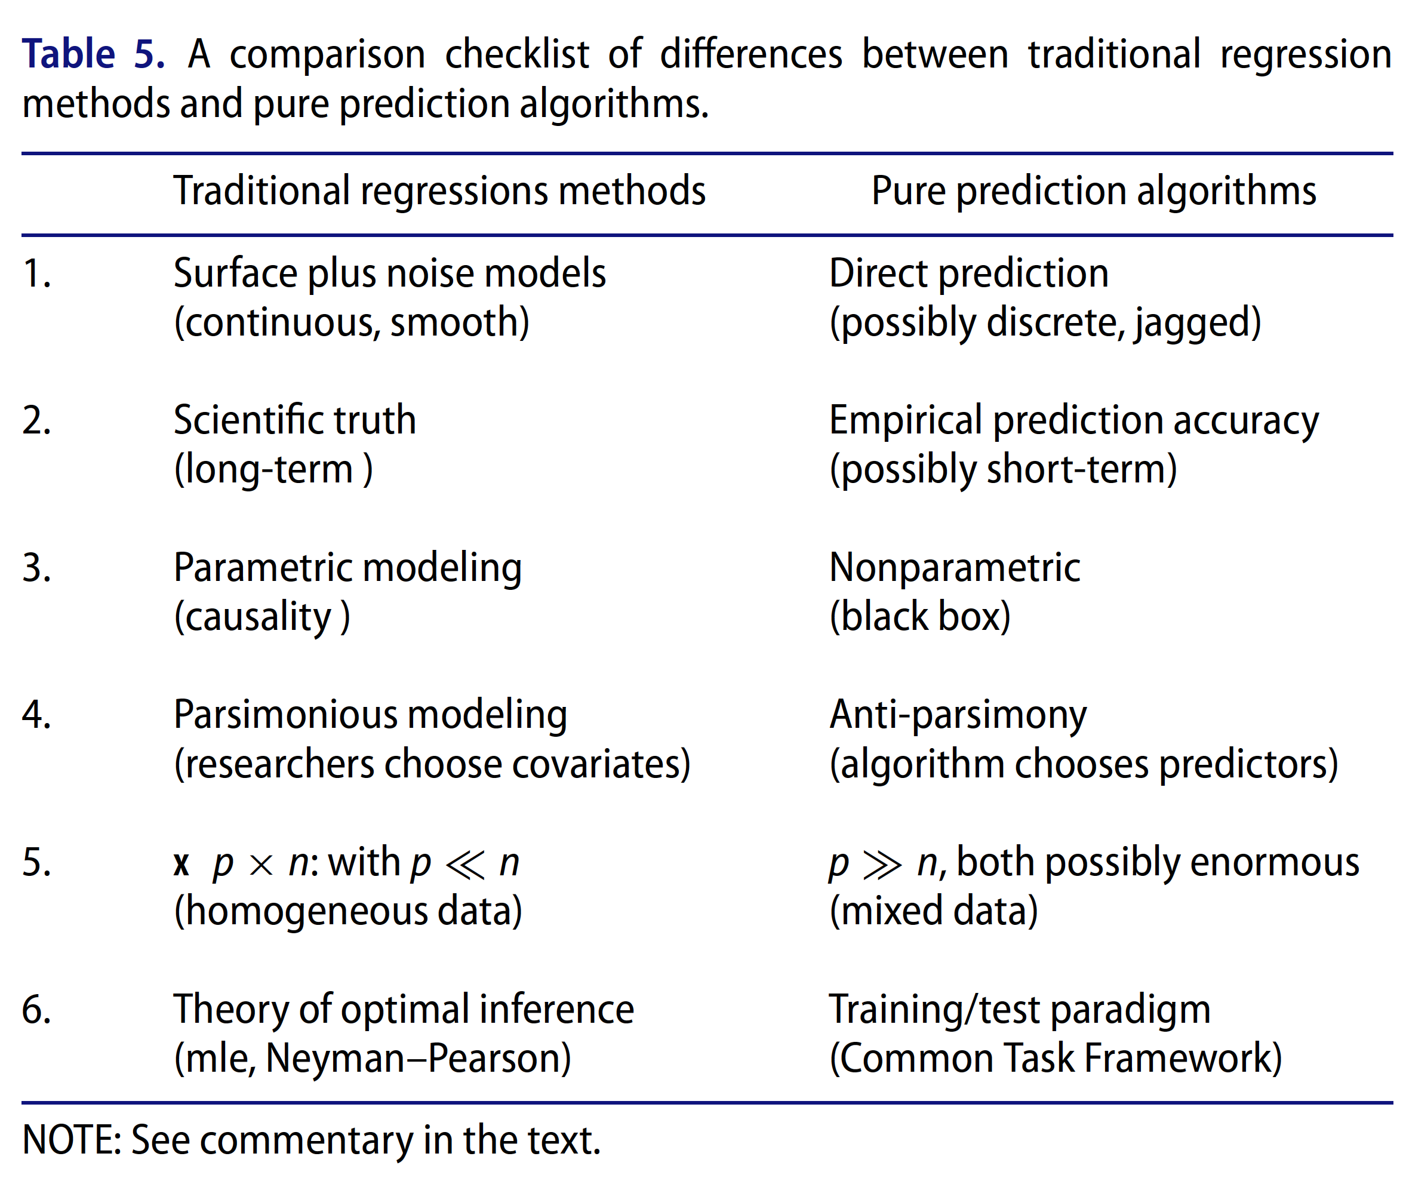
From the assigned reading …

Slide 4
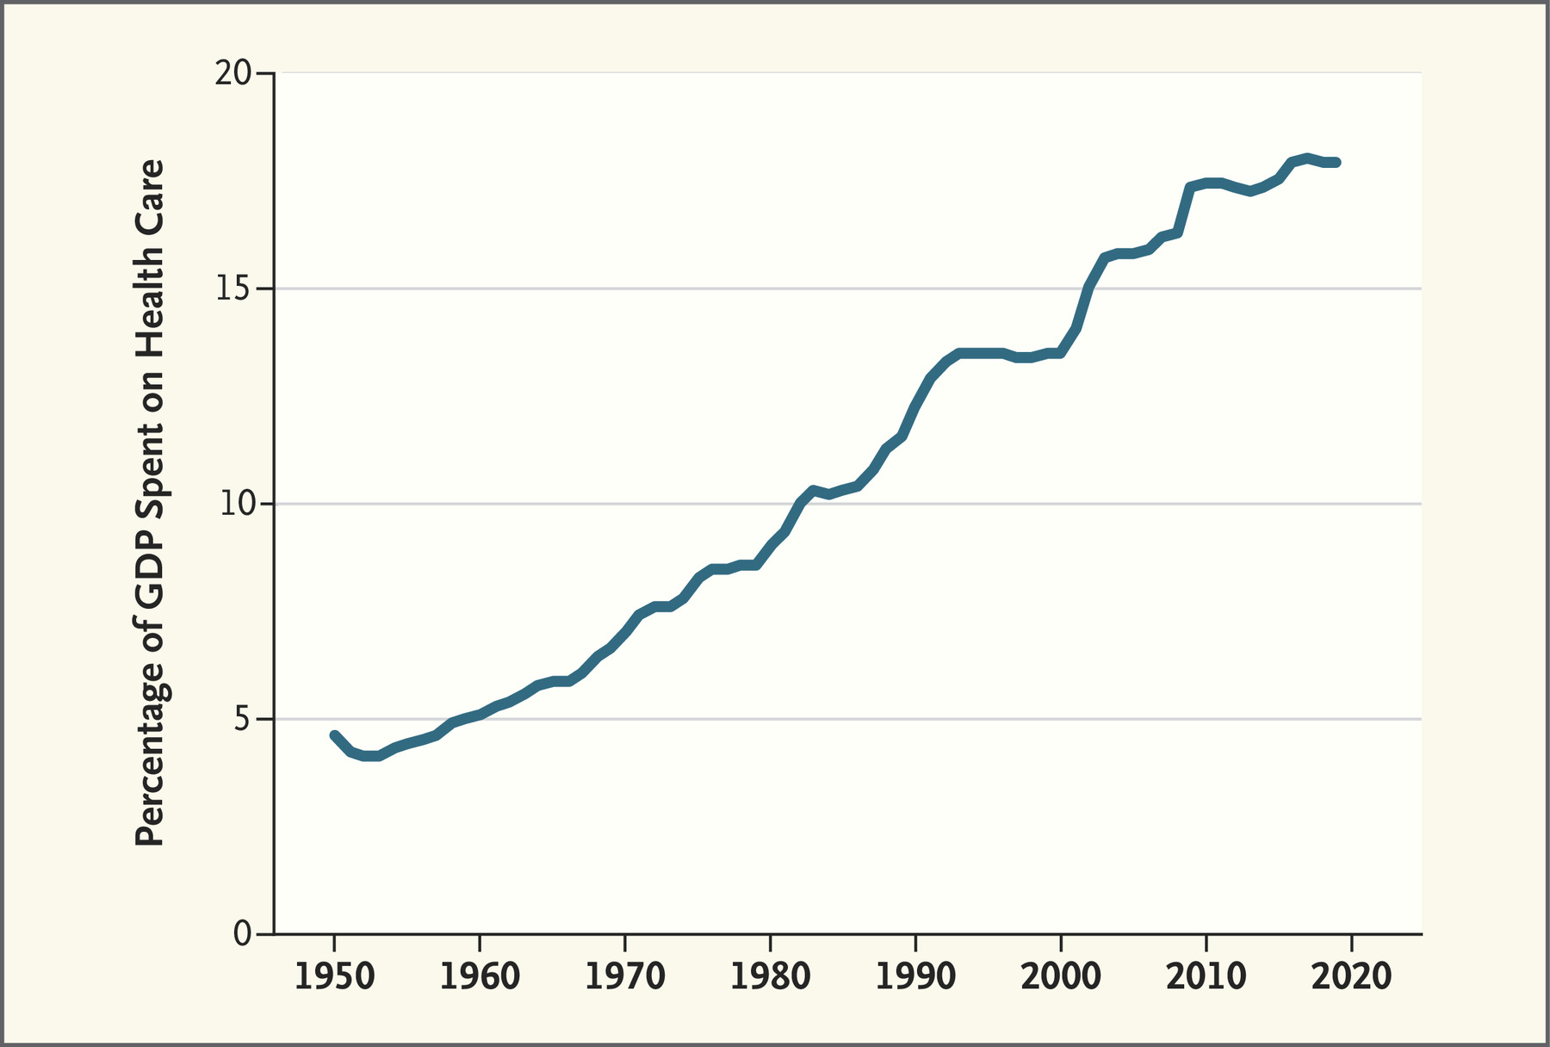
We do a lot, without knowing what works
Skinner et al, N Engl J Med 2022; 386:709-711 | DOI: 10.1056/NEJMp2114227
Notes:
Ratio of National Health Expenditures to GDP, 1950 to 2019.
Data are from the U.S. Social Security Administration 1976 Compendium of National Health Expenditures Data and the Federal Reserve Economic Data database at the Federal Reserve Bank of St. Louis. GDP denotes gross domestic product.

Slide 5
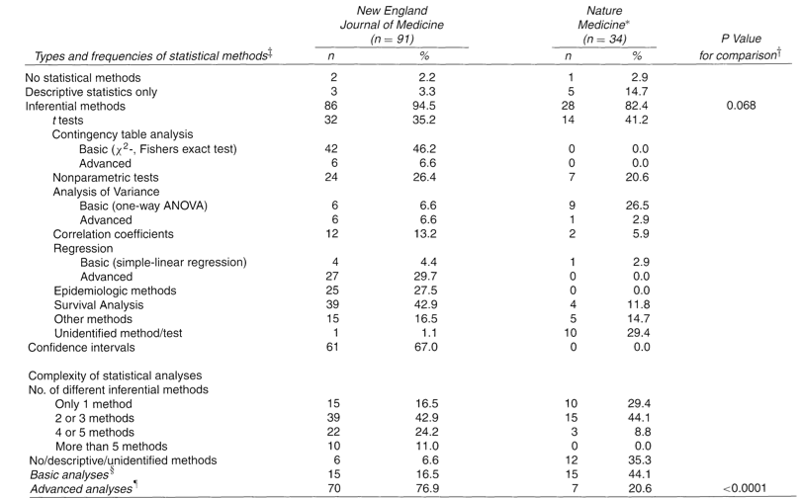
Why care about inferential analysis?
Strasak et al 2007. The use of statistics in medical research: A comparison of the “New England Journal of Medicine” and “Nature Medicine”. American Statistical Association 61(1): 47-55.

Slide 6
Goals for today
Understand what is a statistical model
Understand how model fitting works
Understand confidence intervals and hypothesis testing
multiple hypothesis testing – as self-study
How to choose the right model in the context of the question
The type of the model
The structure of the model

Slide 7
What is a model

Slide 8
A statistical model is a set of assumptions about how the data are generated
sampling
Data
y
12
…
1435
13
Y ~ 𝒩(μ,σ²)
Notes:
Cartoon example: weight being a function of height.

Slide 9
A model describes a family of probability distributions represented by alternative values of the model parameters
Model
Y ~ 𝒩(μ,σ²)
Probability distributions allowed by the model
parameters
Equivalent notation:
Y = μ+ ε, ε ~ 𝒩(0,σ²)
P(y)
Generally:
Y_{i} = x_{i}β + ε_{i}, (i = 1, 2, … n), ε_{i} ~ 𝒩(0,σ²)
y

Slide 10
Statistical inference
Aims to infer properties of a population given a smaller, observable sample
sampling
Data
x_{s} | y_{s}
0.12 | 12
… | …
19 | 1900
0.2 | 20
Data-generating process or population, characterized by parameter θ
inference
Focus on:
How big is θ? (parameter estimation) … effect size
Are we sure θ is not 0? (hypothesis testing) … significance testing
Notes:
Associative analysis methods (aka measures of association) enable comparison between groups to determine if the observed incidence or prevalence of an event is statistically significant, that is significantly different from what would be expected by chance if the event was not at all associated with the factors you’re investigating.
Attribute MedStats

Slide 11
Fitting Models

Slide 12
Inference (model fitting) finds parameters that are likely, given the data and the model
Data
x | y
0.12 | 12
… | …
19 | 235
0.2 | 22
Y ~ 𝒩(θx,σ²)
inference
Maximum likelihood is a common way to do this

Slide 13
Given these parameters, how likely are the data?
Likelihood = 0.004
Data
Likelihood = 0.036
x | y
0.12 | 12
… | …
19 | 235
0.2 | 22
Y ~ 𝒩(-1x,0.5)
Likelihood = 0.09
Y ~ 𝒩(0x,0.5)
Y ~ 𝒩(1x,0.5)
…

Slide 14
Inference – visual
θ
σ
Likelihood

Slide 15
Confidence intervals and Hypothesis testing

Slide 16
The data vary, so our parameter estimate vary
Sampled
Data
x_{s} | y_{s}
0.12 | 12
… | …
19 | 1435
0.2 | 13
x_{s} | y_{s}
0.21 | 12.6
… | …
93 | 135
0.2 | 13
x_{s} | y_{s}
0.12 | 12
… | …
19 | 1435
0.2 | 13
x | y
0.12 | 12
… | …
19 | 1435
0.2 | 13
Estimate
Real World
^
sampling distribution of θ
^
θ
Notes:
Can we figure out how much we expect our parameter estimate to vary? → This is called the variance of the estimate
Use to build confidence intervals and do hypothesis tests

Slide 17
What if the “real world” is the model with θ = θ₀?
Hypothetical
Data
x_{s} | y_{s}
0.12 | 12
… | …
19 | 1435
0.2 | 13
x_{s} | y_{s}
0.21 | 12.6
… | …
93 | 135
0.2 | 13
Y ~ 𝒩(θ₀x,σ²)
x_{s} | y_{s}
0.12 | 12
… | …
19 | 1435
0.2 | 13
x | y
0.12 | 12
… | …
19 | 1435
0.2 | 13
Estimate
^
sampling distribution of θ given θ = θ₀
^
θ
Notes:
Often you can calculate the sampling dist. under the null analytically
There are also ways to do this with the bootstrap
Cartoon example: We say weight has nothing to do with height (hence theta = 0). Under that assumption, we generate the expected distribution of weight, and then compare with what we have in our sample.

Slide 18
With large sample size, what do you expect to happen to these distributions? Justify your answer think-pair-share

Slide 19
What large sample sizes, these distributions become narrower. What might that do to:
Your decision about declaring them “separated enough”?
Your belief about the interval in which the true value lies?
^
^
sampling distribution of θ given θ = θ₀
sampling distribution of θ based on the data
^
^
θ₀
θ₁

Slide 20
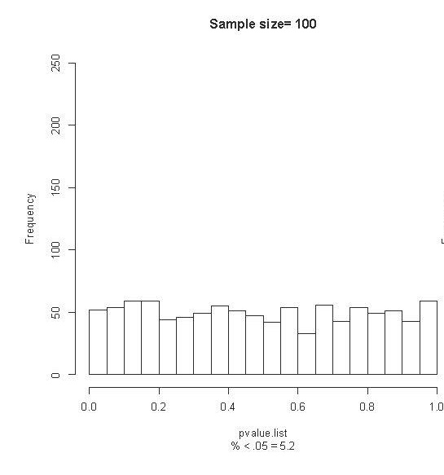
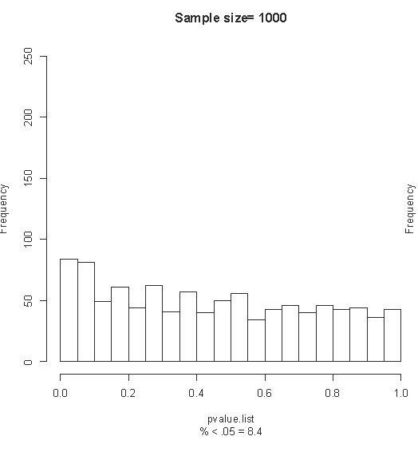
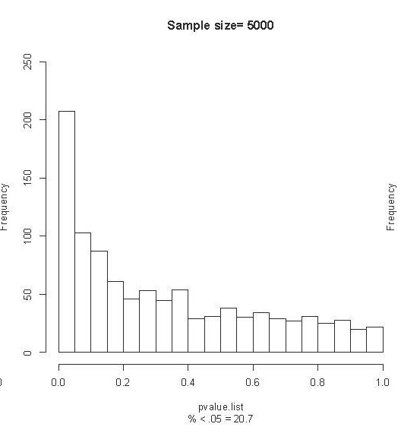
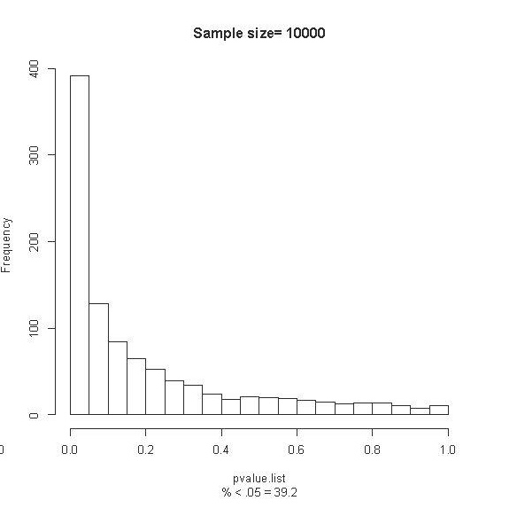
Empirically estimated reliability of p-values
Must assess whether the magnitude of the difference is clinically relevant
Zimmerman N. A Computational Approach to Identification and Comparison of Cell Subsets in Flow Cytometry Data. Stanford University; 2011.
Notes:
There are 3 factors that affect the power of a statistic to identify differences: sample size, population variance and effect size.
If one fixes effect size and population variance for a given experiment and changes only the sample size, one can tweak the significance values to find significant differences in data that appears otherwise similar.
To illustrate this principle we compare two hypothetical patient groups (n=100,000 each), treated with placebo and drug. The outcome measure is systolic blood pressure, which differs between the two groups by 0.5%. We randomly sample k patients from each group and, using a two-sample t statistic, calculate a p value under the null hypothesis that there is no difference in systolic blood pressure between the two groups. This “trial” is performed with 1,000 random samples of size k from the original patient groups yielding a distribution of p-values.
Performing these trials over a range of values for k demonstrates the behavior of statistical significance in the presence of varying levels of evidence. When k=100, we only detect the modest difference between the two groups at an arbitrary threshold of statistical significance (p 0.05) 5.2% of the time. As we increase the size of k, the distribution of p-values shifts such that more and more trials become significant. In the final panel (k=10,000), 40% of the trials demonstrated statistically significant differences.
A statistically significant difference absent in smaller trials suddenly reveals itself in the large trials.
Type I error – falsely rejecting the null hypothesis when there is no effect (this will happen 1 in 20 times when p-value threshold is 0.05)
Type II error – failing to reject the null hypothesis when there actually is an effect
Statistical power is the inverse of type II error – the chance of detecting a true effect if it exists
Studies typically aim for a power of 80% - meaning that researchers will miss a true effect 20% of the time
Power = how often will you not make a type II error
You never really know your power, but you can estimate it based on what you think the effect is and what your model is

Slide 21
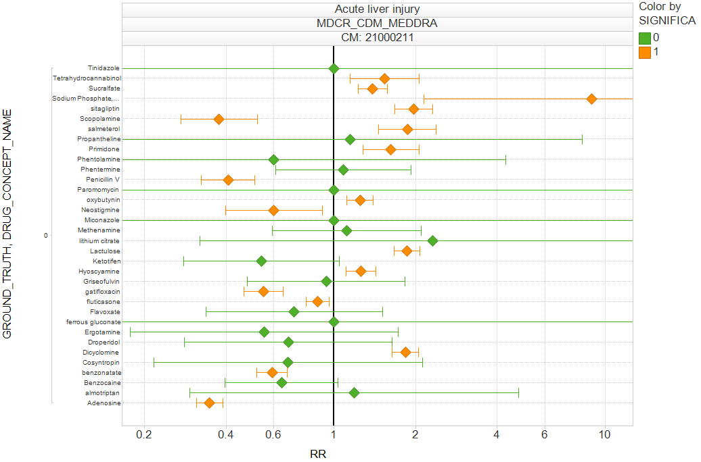
Empirically estimated reliability of confidence intervals
17 of the 34 confidence intervals
contain the true value!
34 negative controls
Ryan PB, Stang PE, Overhage JM et al, Drug Safety, 2013: “A Comparison of the Empirical Performance of Methods for a Risk Identification System”
Notes:
Acute liver injury, 34 negative controls
Cohort design to 34 negative controls for acute liver injury.
95%*34 = 32 of the estimates should cover RR = 1
Found 17 of negative controls did cover RR=1
Coverage prob. = 17 / 34 = 50%

Slide 22
Empirical Calibration

Slide 23
Using negative controls to create an empirical “null”
Situation where we know there is no effect
database
Situation where we know there is no effect
Situation where we know there is no effect
x_{s} | y_{s}
0.12 | 12
… | …
19 | 1435
0.2 | 13
Situation where we know there is no effect
x | y
0.12 | 12
… | …
19 | 1435
0.2 | 13
Situation where we know there is no effect
Situation where we know there is no effect
Situation where we know there is no effect
Our study
Estimate
Empirical p-value
(estimated false discovery rate)
^
θ
Notes:
Negative control: the outcome is not caused by the exposure
E.g. An outcome that happens before the exposure
E.g. Good RCT evidence for no relationship
Positive control: the outcome is known to be caused by the exposure
E.g. Good RCT evidence for a relationship

Slide 24
Calibration using negative controls:
Identify a set of K negative control exposure-outcome pairs
Using the same study design as for your main study, estimate the effect of each exposure and its corresponding negative outcome
The set of effect size estimates you get is your null distribution
Compute an empirical p-value as: the percentage of the null effects that are greater than the effect you calculated for your study

Slide 25
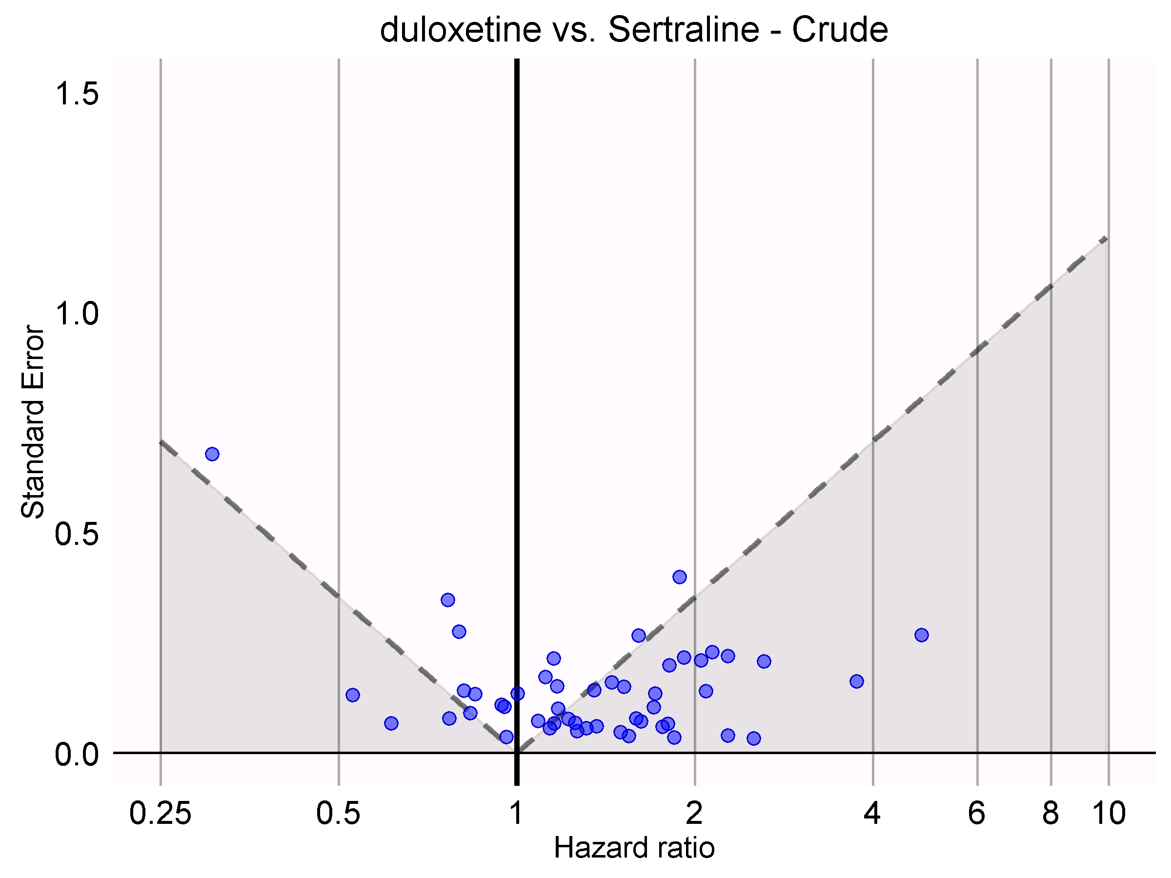
Calibration using negative controls
We would expect 5% of negative controls
to have p < 0.05
Not statistically significant
Statistically significant
Calibrated p < 0.05
Schuemie, M. J., Ryan, P. B., DuMouchel, W., Suchard, M. A., & Madigan, D. (2013). Interpreting observational studies: why empirical calibration is needed to correct p-values. Statistics in Medicine, 33(2), 209–218. http://doi.org/10.1002/sim.5925
Notes:
We would expect 5% of negative controls to have p < 0.05
Instead, 68% has p < 0.05!

Slide 26
Empirical calibration of confidence intervals is harder to do than the calibration of the p-value using negative controls, because it requires that you know the true value of the thing you are trying to estimate.
We are not going discuss this.

Slide 27
You are studying the impact a new device for mitral valve replacement vs. an older device. The outcome is 1-year readmissions for complications. What do you think would make for a good negative control in this study?
Notes:
Call on people, write their strategies on the board and organize them in a way that they reflect the next few slides

Slide 28
Quick recap:
A statistical model defines a class of possible data-generating probability distributions
Model fitting picks the distribution that’s most likely to have generated the data you see
Confidence intervals and hypothesis testing are ways to quantify variation in our estimate that comes from the randomness of sampling the data
With large samples, you get narrow confidence intervals and “significant” p-values for free.

Slide 29
Choosing the right statistical model
Remember:
A model is a set of assumptions about how the data are generated
We must pick the right type and structure

Slide 30
Choosing a model type
Outcome | Model
Continuous | Linear regression
Categorical | logistic regression
Time-to-event | Cox proportional hazards regression
Associative Analyses lectures (10, 11, 12) from 2017 go into a lot more detail. Links on the last slide in this lecture.

Slide 31
Choosing (selecting) the model structure
You have data (Y, X₁, X₂) and fit two models:
1)
2)
You’re interested in β₁. The two models give different estimates and confidence intervals. What do you do?
Quietly write down any strategies you think of
Notes:
Call on people, write their strategies on the board and organize them in a way that they reflect the next few slides

Slide 32
Comparing Likelihoods or “Goodness of Fit”
Models are fit by maximizing a likelihood.
We can compare the likelihood of the data given each model and pick the best.
Examples :
Compare R² (proportion of variance explained)

Slide 33
Problem: you can always improve your fit by adding more parameters or complexity to your model (overfitting)

Slide 34
What we want is an estimate of error on new data
Penalize the complexity of the model
Use another dataset and compute the likelihood of that data given each model
Get another sample from the same data-generating process as the training data
Beware: Such model selection breaks inference and confidence intervals are no longer valid.
Notes:
Our field’s attachment to “external validity”.

Slide 35
Optional videos: In depth material
Associative Analyses lectures from 2017
https://tinyurl.com/2017-L10
What is a model
Fitting models
How precise are our estimates?
Hypothesis tests
https://tinyurl.com/2017-L11
Choosing a Statistical Model
Models for Correlated Observations
Multiple Hypothesis Testing
https://tinyurl.com/2017-L12
Model Selection
Empirical Calibration
Jupyter notebooks to illustrate the concepts
Notes:
https://drive.google.com/open?id=198V07B4ur4P5r1v5dGUvJ0ueCo7fT0DS
https://drive.google.com/open?id=1D0te5W_uTUfnt4O5bNAzy3k64_IJoDQA
https://drive.google.com/open?id=1Uc7agkMi0epAKxMiZZxSqZjmNXpFmw7r

Slide 36
Self-study: Multiple Hypothesis testing

Slide 37
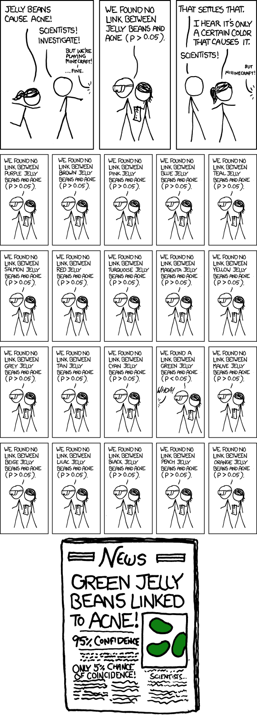
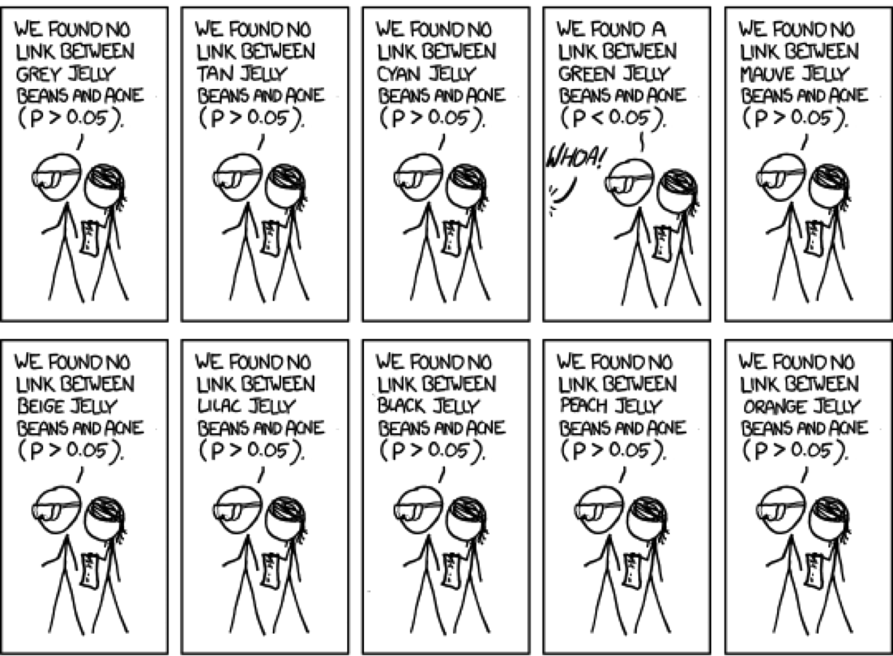
Multiple Hypothesis Testing

Slide 38
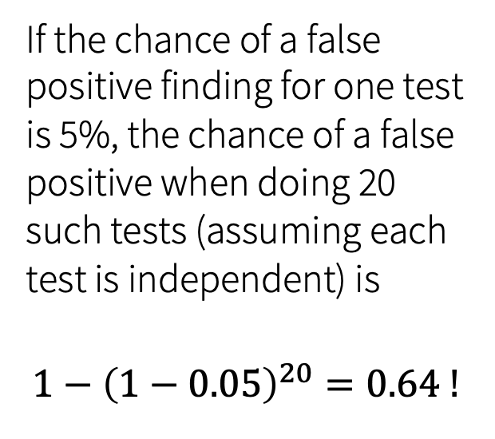
If the chance of a false positive finding for one test is 5%, the chance of a false positive when doing 20 such tests (assuming each test is independent) is
$$1−{\left(1−0.05\right)}^{20}=0.64 !$$

Slide 39
Correcting for multiple testing
Bonferroni correction
lowers threshold for statistical significance based on the number of tests you are doing e.g. 2 tests → 0.05/2 → 0.025 p-value cutoff
assumes that all tests are independent, which is not likely the case – highly conservative
Benjamini Hochberg procedure
Uses a set false discovery rate (⍺) to find a significance threshold for p-values
Tukey’s Honest Significant Difference (HSD) test
Determines if a difference in means is significant while controlling for false discovery rate

Slide 40
Reflection question: What are some reasons that multiple testing might be reasonably done in a study?
Multiple outcomes
Multiple predictors
Multiple time points at which outcome is observed

